Slide 1
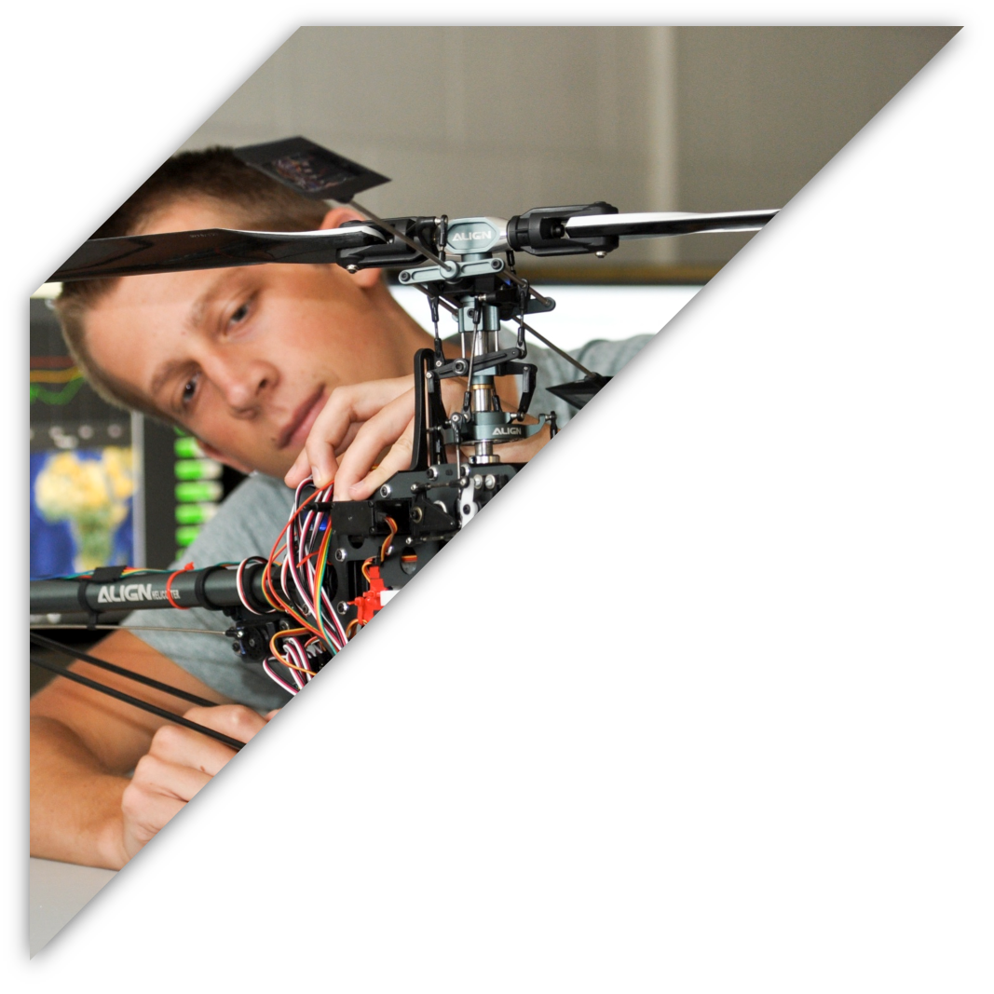

ECEN 403
GAN Assisted Map Reconstruction for first responders using Sensor Fusion:
Christian Jeardoe, Quinn LeBoeuf
Kyle Smejkal, Rufus Tadpatri

Slide 2

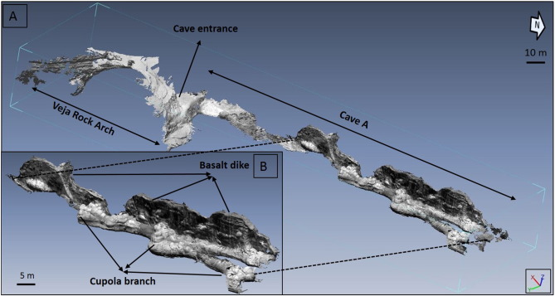
Problem Statement
Emergency situations often require first responders to delve into dangerous environments with minimal information. (fires, gas leak, rescues)
Fires, gas leaks, cave rescues, and radioactivity are examples of hazards in various environments

Slide 3
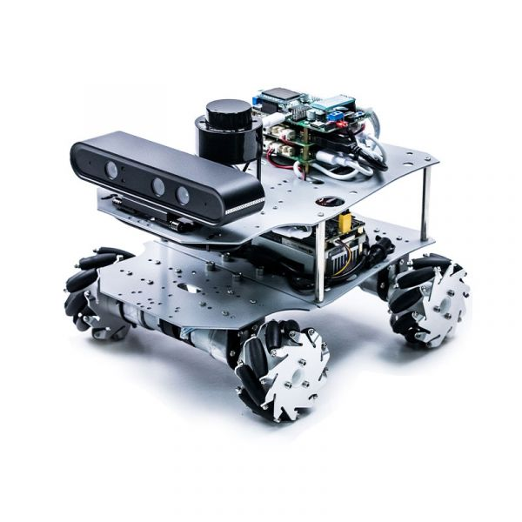
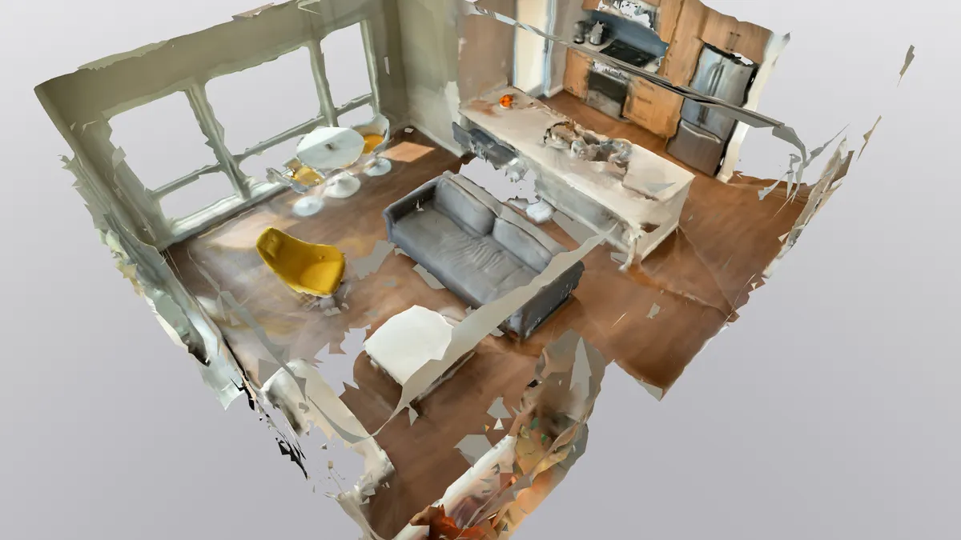
Solution Proposal
Create a multi sensor, GAN assisted, map reconstruction program that can be utilized on a mobile platform to create a virtual 3D twin of any environment.

Slide 4
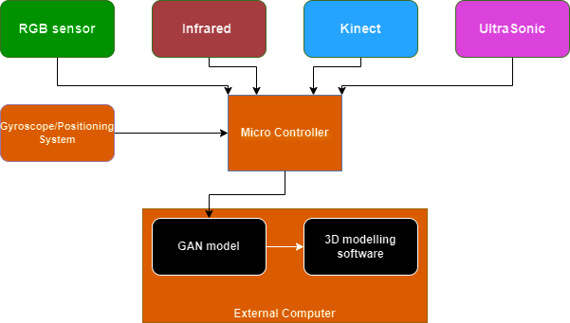
Diagram of Subsystems and Interface

Slide 5
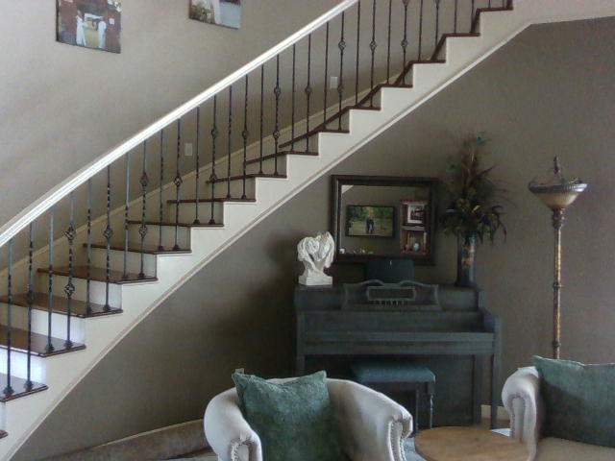
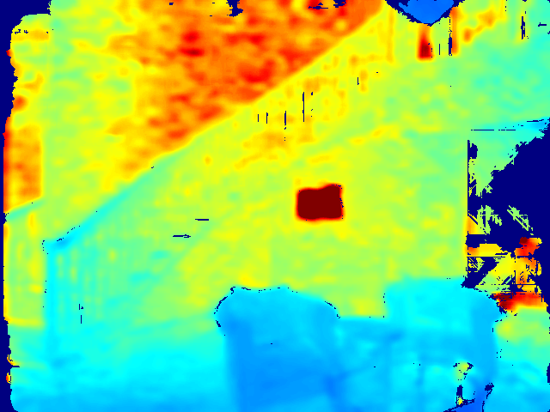
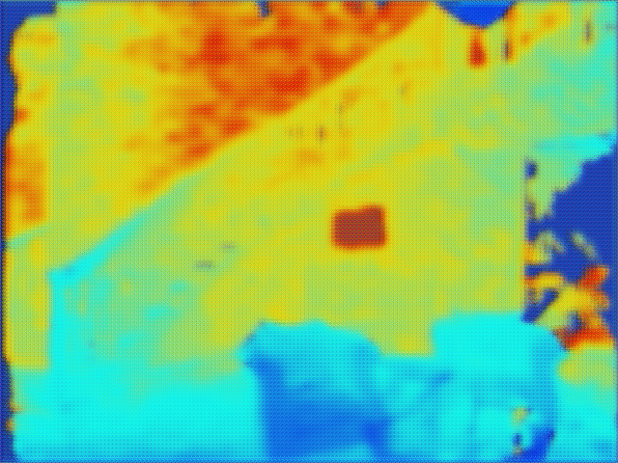
RealSense (RGB-D)
Christian Jeardoe
Engineering Design Accomplishments
Created a data collection program for the RealSense camera.
Designed, trained, and tested GAN model for depth map refinement and enhancement.
Program loads depth map dataset and for each image creates a copy of it and places a mask over it resulting in missing data, which model tries to correct for.

Slide 6
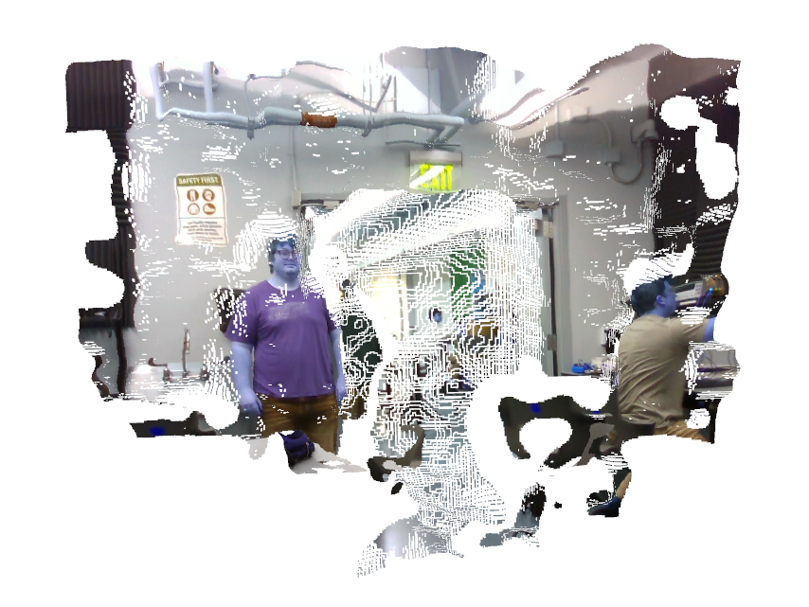
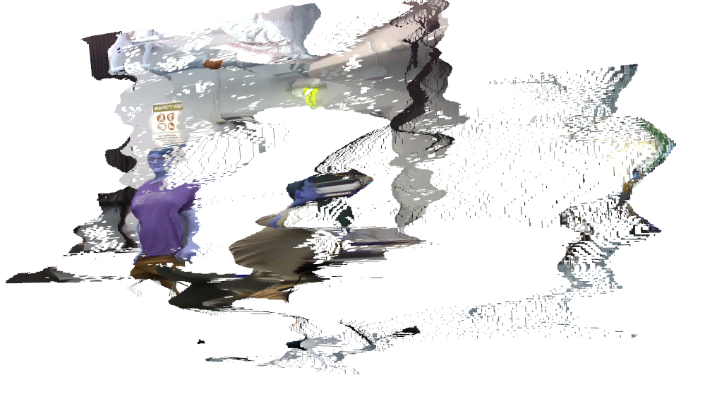
RealSense (RGB-D)
Christian Jeardoe
Designed a program that generates a 3D point cloud mesh from the RealSense camera and displays it

Slide 7
RGB Sensor Subsystem
Trained Model
Model was trained on dataset with ~150 images
Breakpoint tests in code shows the generator is being trained
Point cloud generator runs, as proven by breakpoint tests in code
Point cloud generation needs to be improved - point cloud is unsatisfactory
Point cloud fails when using sensor for input

Slide 8
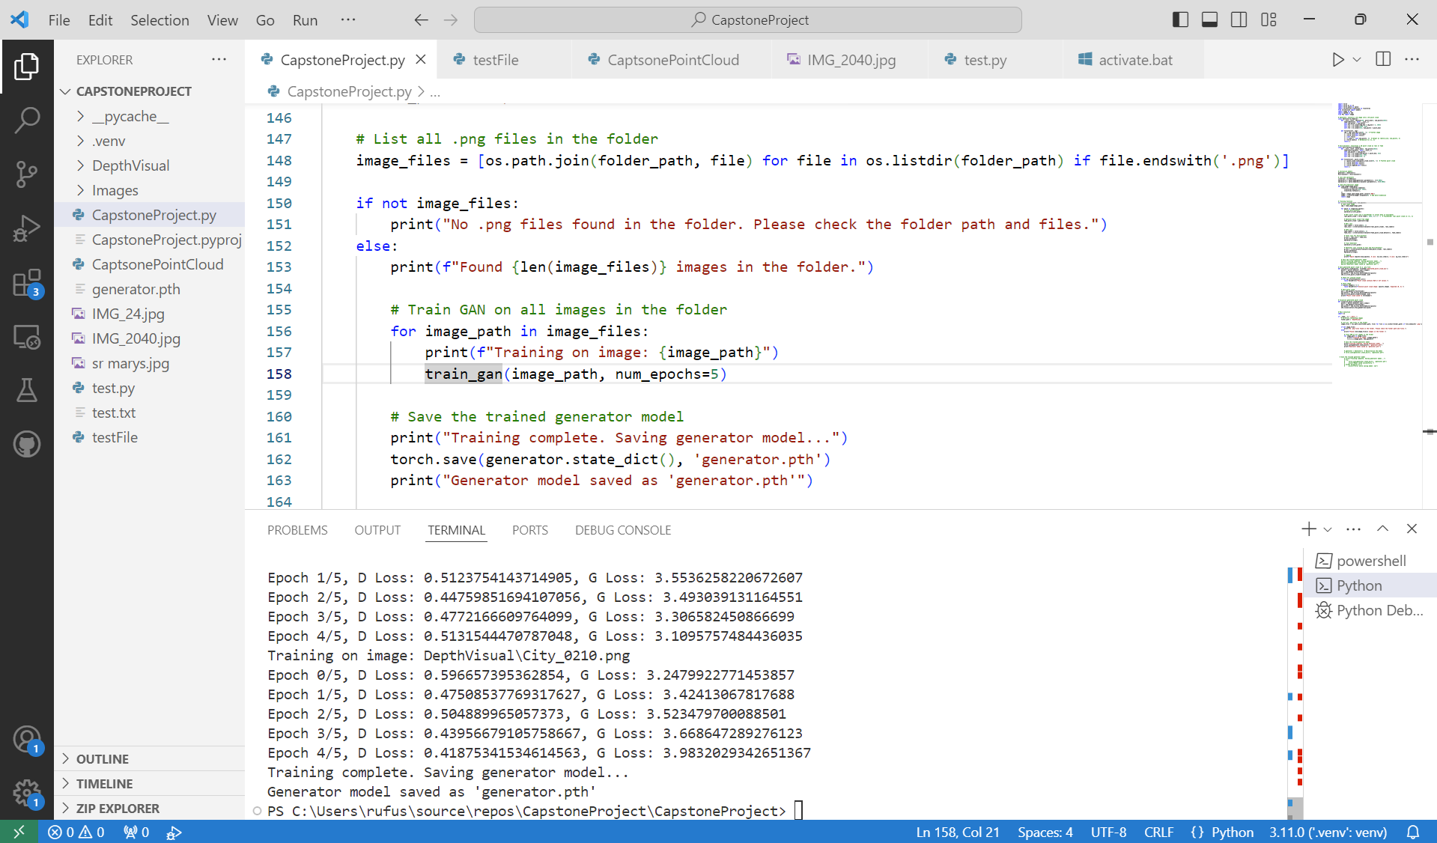
RGB Sensor Subsystem

Slide 9
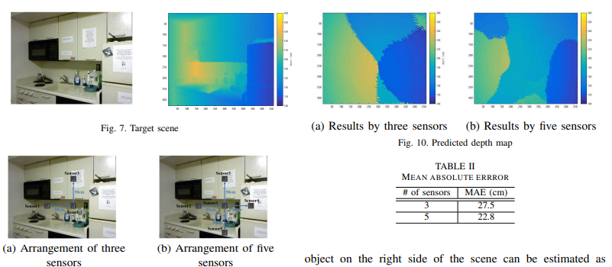
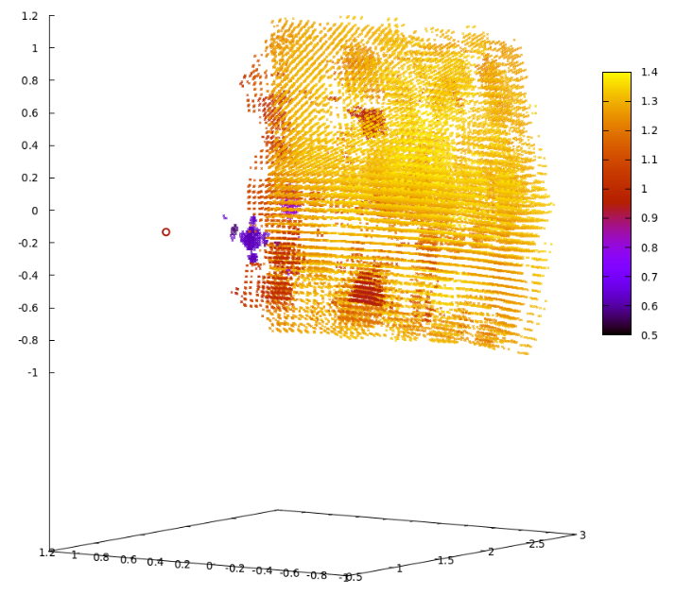
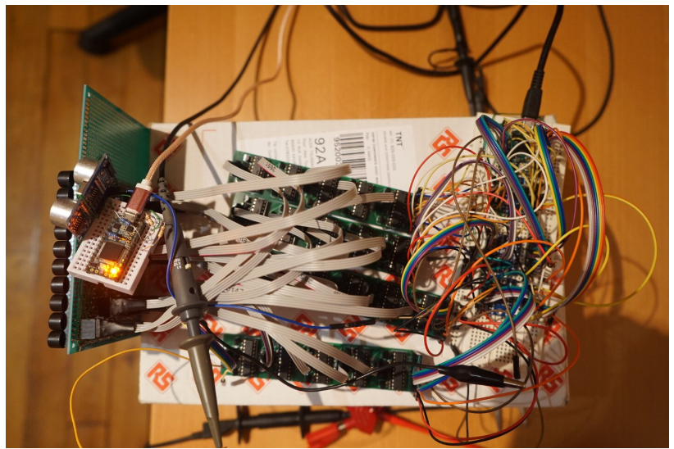
-Ultrasonic Sensor-
Quinn LeBoeuf
Accomplishments:
Fully developed partially trained cycle GAN model
Depth map enhancement
Inferred RGB image
Point cloud development from depth single depth images
Improvement/future design:
Before Demo:
Fully trained model (2-3 days of training data)
Partial sensor data collection
404 continuation:
Ultrasonic 3D scanner development
Sensor fusion and GAN model integration
Demo Scanner Goal (http://www.apsipa.org/proceedings/2021/pdfs/0000288.pdf)
Future Ultrasonic Scanner Goal (https://www.alextoussaint.com/2021-04-28_How-I-built-an-ultrasonic-3d-scanner.html

Slide 10
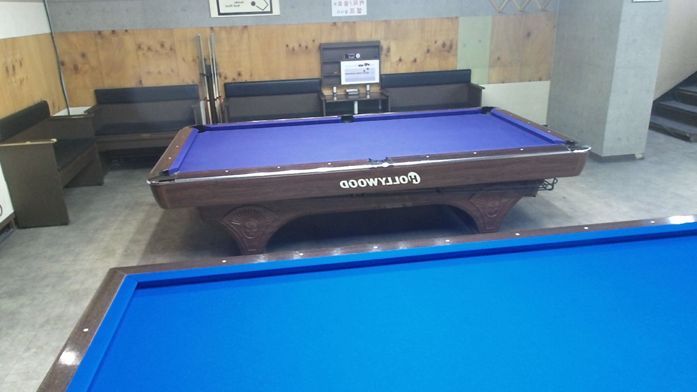
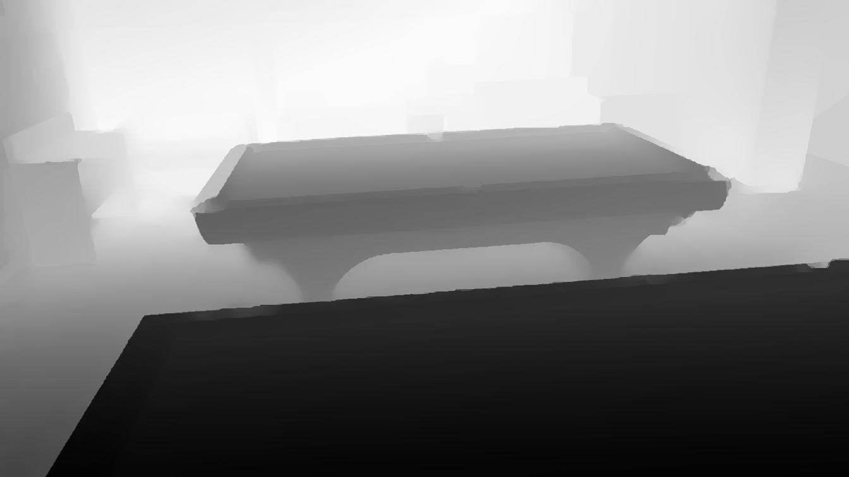
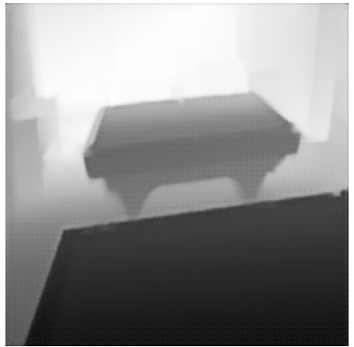
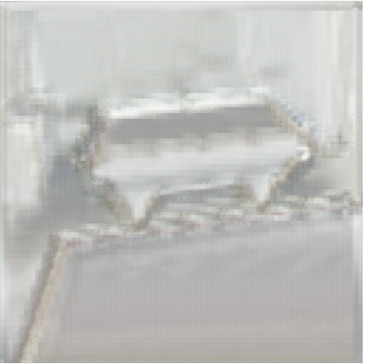
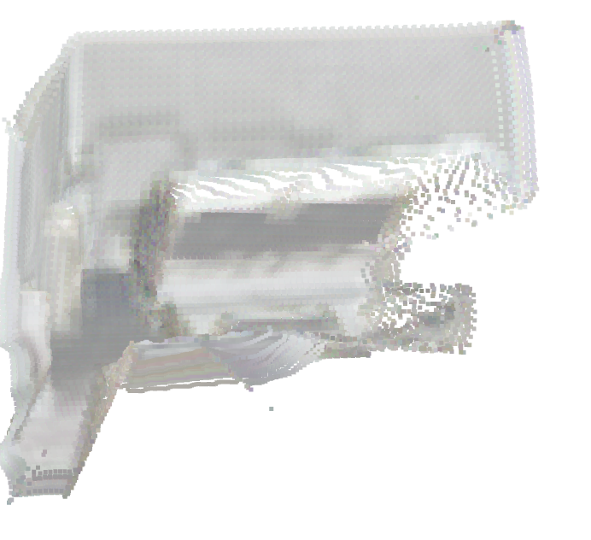
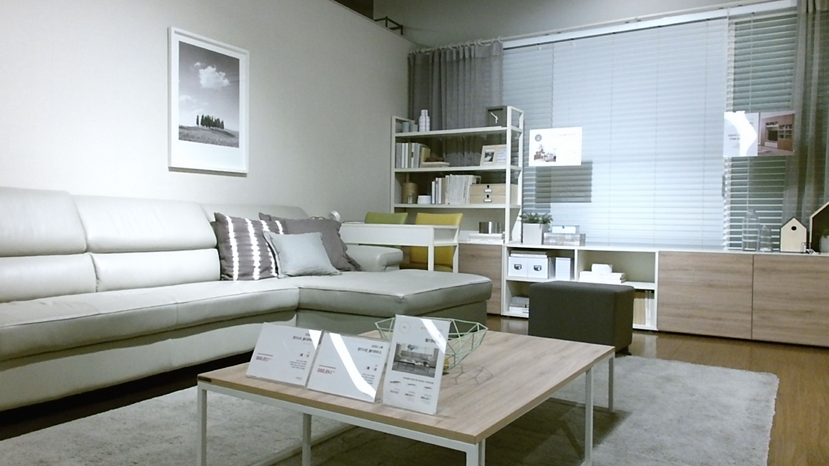
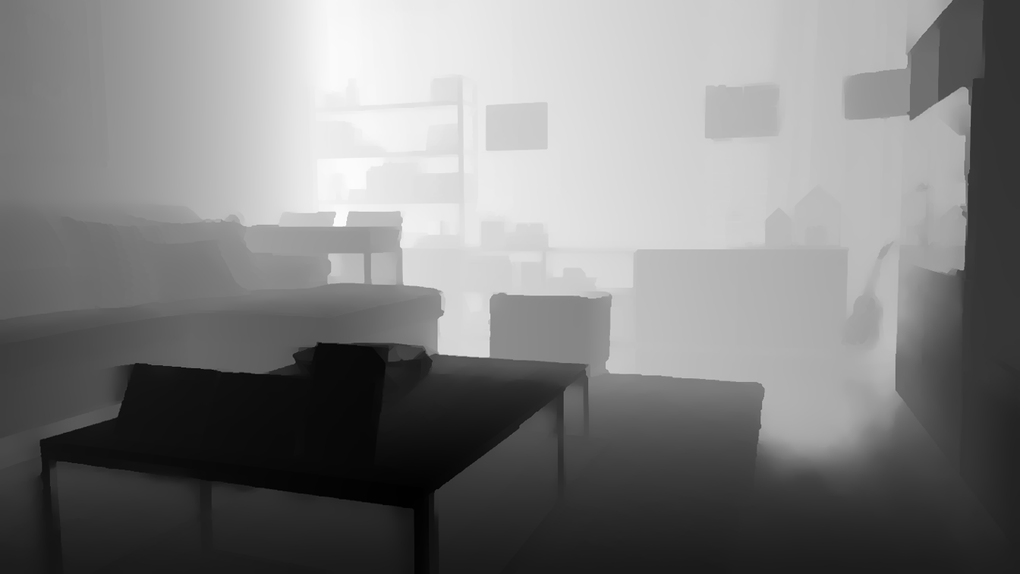
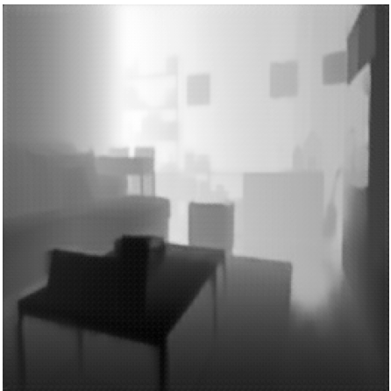
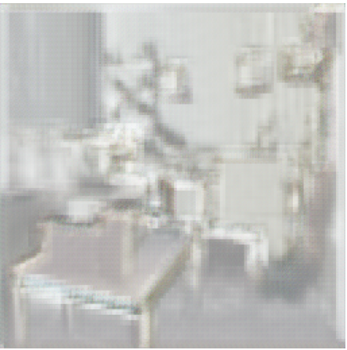
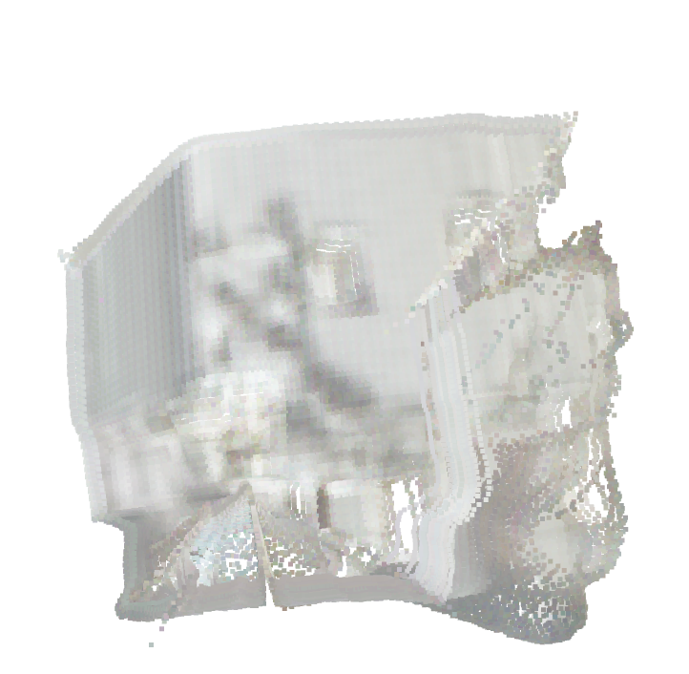
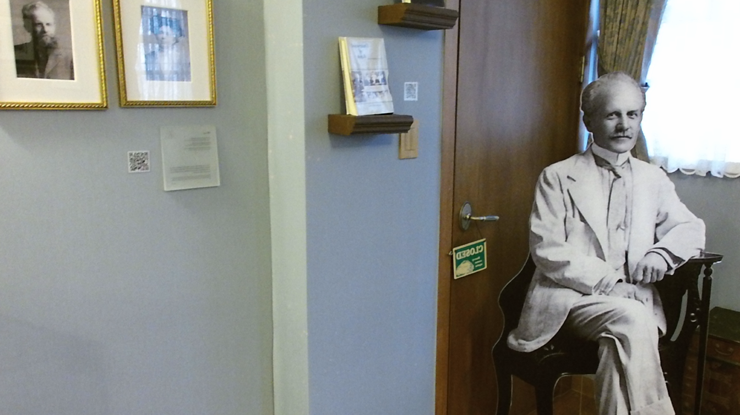
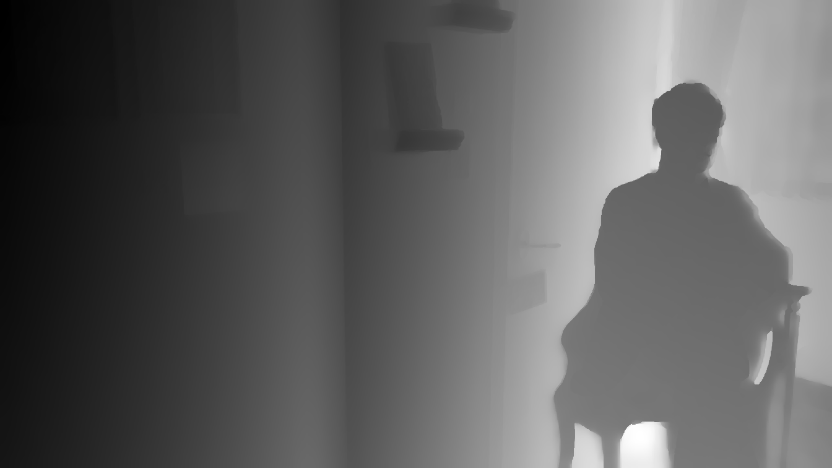
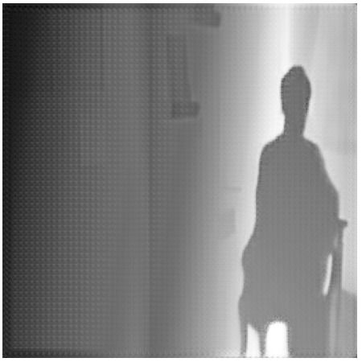
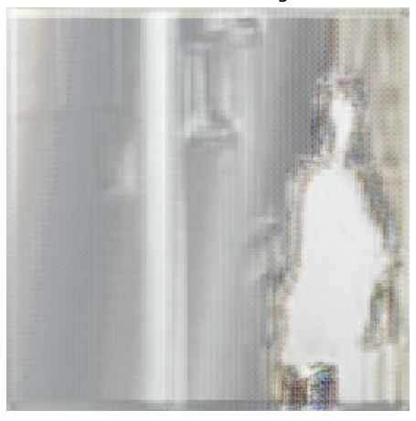
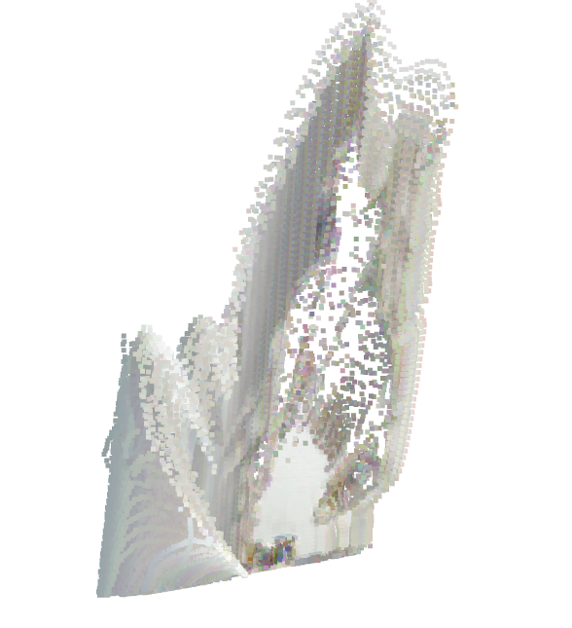
-Ultrasonic Sensor-
Quinn LeBoeuf
RGB Image | Depth map (noisy or clean) | Improved Depth Map | Inferred RGB Image | Point cloud
(GROUND TRUTH) | (INPUT DATA) | (OUTPUT DATA) | (PROCESSED OUTPUT)

Slide 11
-Infrared Sensor-
Kyle Smejkal
Progress:
Set up Mlx90640 thermal imaging camera on Raspberry pi for capturing infrared data
Collect depth image from realsense camera
Trained GAN model for infrared data and for depth images
Created point cloud from thermal and depth image
Improvements to be made:
Increase resolution of thermal images and point cloud
Gather larger sample dataset for training
Further train the GAN model

Slide 12
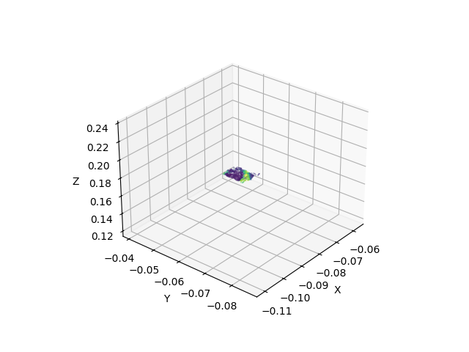
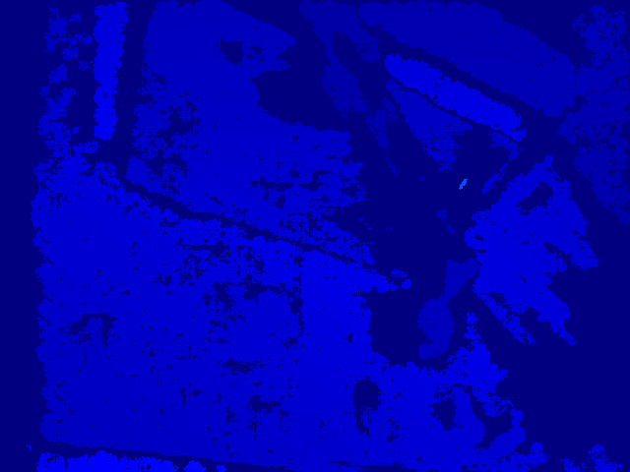
-Infrared Sensor-
Kyle Smejkal

Slide 13
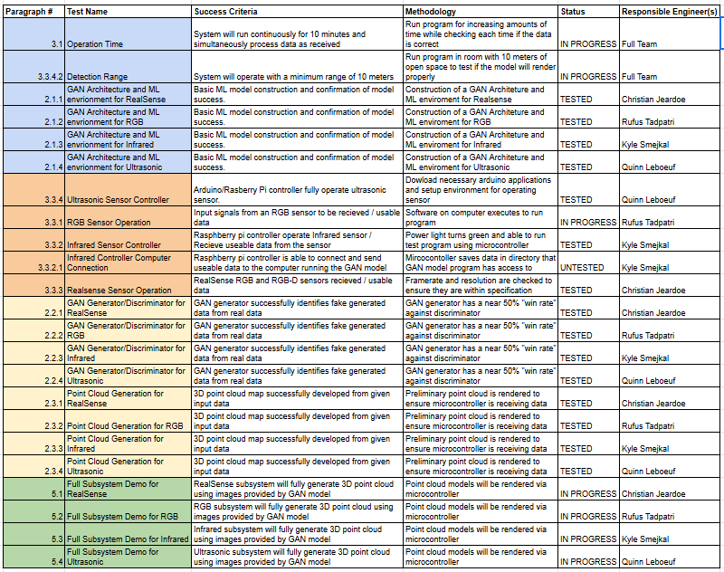
Validation Plan

Slide 14
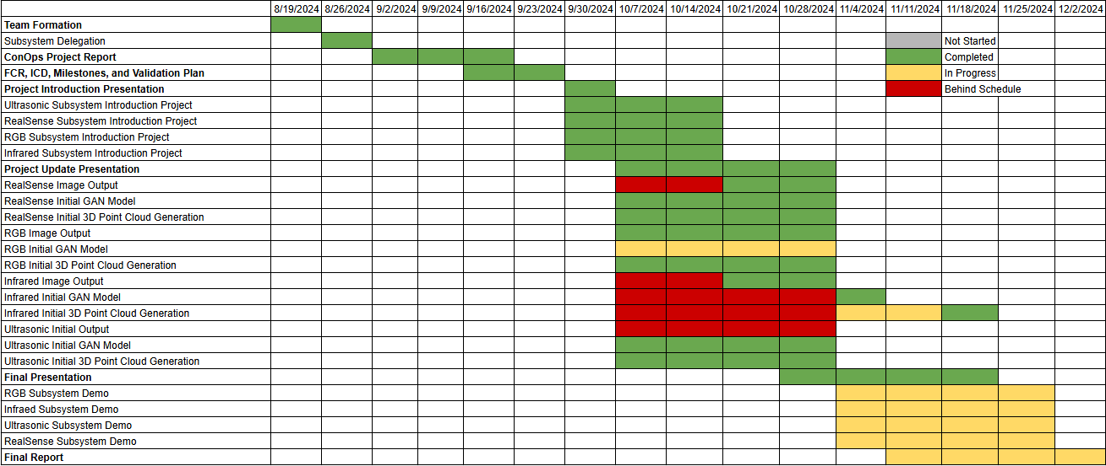
Execution Timeline

Slide 15
Remaining Tasks
Things to Complete before Project Demo:
RealSense: Currently my discriminator is too weak and needs to be tweaked.
RGB: Point Cloud generation needs to function from input images
Infrared: Increase resolution of thermal images
Ultrasonic: Fully trained model (2-3 days of training data) and partial sensor data collection
Key Subsystem Designs to be Completed in 404:
RealSense: A much larger dataset needs to be collected to train GAN model better, need to link input, GAN model, 3D point cloud generator, and have all run in realtime.
RGB: Second generator/discriminator will need to be added to work in unison with depth images
Infrared: Capturing data and the image/point cloud generation take place on two devices now, but need to be on one device
Ultrasonic:Ultrasonic 3D scanner development and sensor fusion and GAN model integration

Slide 16
Thank you

